Slide 1

Jenkins Advanced

Slide 2

Agenda
Quick Overview
Plugins - Dynamic and Multiselect, Multijob(Used in Xtesting)
Pipelines - Declarative and Scripted
Jobs Backup and Porting
Jenkins Seed Job
Project UseCase – Server Automation
Dynamic Agent configuration
Jenkins X - Introduction

Slide 3
Jenkins Overview
Jenkins is an open source continuous build tool, enables us to focus on automating the build, artifact management, and deployment processes
Jenkins helps to automate the non-human part of the whole software development process right after the developer checking-in the code to integration
Jenkins’ core functionality and flexibility allow it to fit in a variety of environments and can help streamline the development process for all stakeholders involved
Has a vast range of plugin support which allows us to customize the jobs as per the project requirement.
Notes:
End-to-End Automated process
Brief about Ansible and playbooks
Brief about Robot and test suites
Advantages of Automated deployment

Slide 4






Benefits of Jenkins in CI/CD Cycle
Integrate with many different Version Control
Systems
Detect changes in the version control system and automatically builds and tests the code.
Generate test reports
Push to various artifact repositories and Deploy to production or test environments
Notify stakeholders of build status

Slide 5


Jenkins Dev Env flow
Report Bug to Dev
Intimate Dev
Jenkins Server
Developer commits
v3 Code
Jenkins polls
Dev Repository
Dev Server
Dev
Robot Server
GIT Sync
Command to QA for Code Sync
QA Server
QA Server
Fires ROBOT Test Cases for v3
Send Email/Package for Deployment
QA GIT Revert
Master GIT
Master GIT Sync

Slide 6
Plugins
Active Choice Paramter (Link)
Extensible Choice Paramter (Link)
Multijob Plugin

Slide 7
Jenkins API
Jenkins provides machine-consumable remote access API to its functionalities. Currently it comes in three flavors:
XML
JSON with JSONP support
Python
Example :
curl -X POST JENKINS_URL/job/JOB_NAME/buildWithParameters \
--user USER:TOKEN \
--data-urlencode json='{"parameter": [{"name":"id", "value":"123"}, {"name":"verbosity", "value":"high"}]}'

Slide 8

Jenkins Pipeline
Jenkins Pipeline (or simply "Pipeline" with a capital "P") is a suite of plugins which supports implementing and integrating continuous delivery pipelines into Jenkins.
Pipeline provides an extensible set of tools for modeling simple-to-complex delivery pipelines "as code" via the Pipeline domain-specific language (DSL) syntax
A Pipeline can be created in one of the following ways:
Through the classic UI
In SCM - you can write a Jenkinsfile "Pipeline-as-code
The definition of a Jenkins Pipeline is written into a text file (called a Jenkinsfile) which.
A Jenkinsfile can be written using two types of syntax - Declarative and Scripted.
Code
Durable
Pausable
Versatile
Extensible

Slide 9
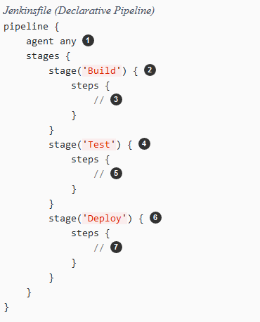
Declarative Pipeline Syntax
Declarative and Scripted Pipelines are constructed fundamentally differently. Declarative Pipeline is a more recent feature of Jenkins Pipeline which:
provides richer syntactical features over Scripted Pipeline syntax, and
is designed to make writing and reading Pipeline code easier.

Slide 10
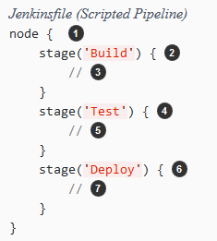
Scripted Pipeline Syntax
In Scripted Pipeline syntax, one or more node blocks do the core work throughout the entire Pipeline. Although this is not a mandatory requirement of Scripted Pipeline syntax, confining your Pipeline’s work inside of a node block does two things:
Schedules the steps contained within the block to run by adding an item to the Jenkins queue. As soon as an executor is free on a node, the steps will run.
Creates a workspace (a directory specific to that particular Pipeline) where work can be done on files checked out from source control.

Slide 11
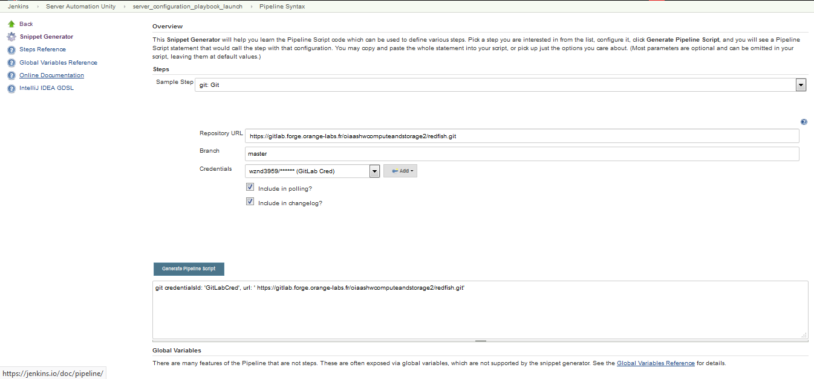
Pipeline Snippet Generator
Snippet Generator will help to learn Pipeline Script code which can be used to define various steps.

Slide 12
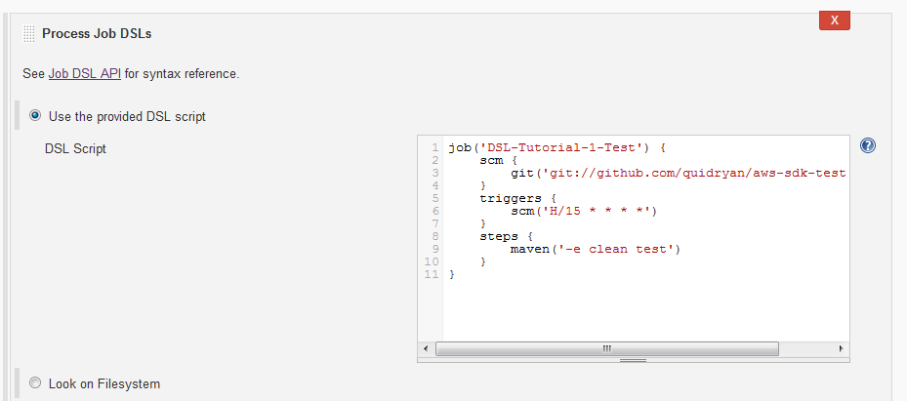
Jenkins Seed Job
Anyone who is familiar with Jenkins knows it’s very tedious to create jobs manually.
The seed job is a Jenkins job which runs a DSL scripts, and then generates a new job.
Out-of-the-box Jenkins does not support seed jobs. To enable it you will need to install the Jenkins Seed plugin and Job DSL plugin.
Once installed, we can create FreeStyle Job ->Build -> Process Job DSLs

Slide 13
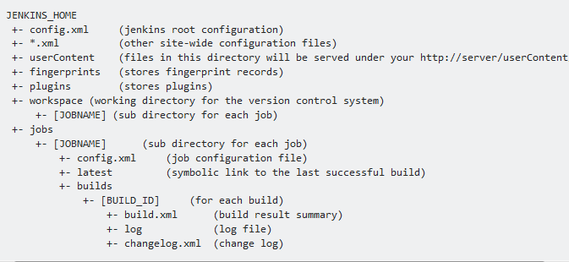
Jenkins Directory Structure
All jobs (jobs/) and master config files (config.xml) can be found in Jenkins home folder

Slide 14
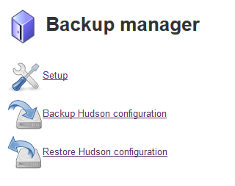
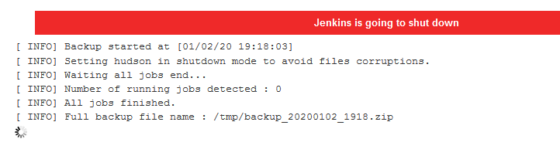
Jenkins BackUp
Jenkins Backup Can be done in multiple ways
Manually Copying Job XML files to GIT
Plugins
Backup Manager
ThinBackup Plugin

Slide 15
Jenkins Migration
Jenkins Job Migration can be also done in multiple ways:
Copy jobs directory
Job Importer Plugin
Jenkins CLI
java -jar jenkins-cli.jar -s http://10.237.140.171:8080/ get-job "server_configuration_playbook_launch“ > job.xml
cat job.xml > java -jar jenkins-cli.jar -s http:// 10.237.140.171:8080 create-job "NAME_OF_JOB“
Reload Configuration from Disk
For plugin migration:
GET request: {SOURCE_JENKINS_SERVER}/pluginManager/api/json?depth=1 will get you the list of plugins installed with their version. http://10.237.140.171:8080/pluginManager/api/json?depth=1
You can send a POST request with the following parameters to install these plugins.

Slide 16
Dynamic Agents
Resource utilization of the slaves will be very less when the builds are not quite often.
In this scenario, it is better to use ephemeral docker containers as your build slaves for better resource utilization.
Jenkins master connects to the docker host using REST API’s. So we need to enable the remote API for our docker host.
After Installing Docker Plugin, Configure the Plugin in Manage
The Docker Image needs to have Java (and sshd ) to use it as a slave
Templates need to be defined for executing on docker slaves

Slide 17

Jenkins X
Its written from scratch, less than 2 years old and its not Jenkins!!
Automated CI/CD Solution for modern cloud applications on Kubernetes
Developers and teams don’t have to spend time figuring out how to package software as docker images, create the Kubernetes YAML to run their application on kubernetes, create Preview environments or even learn how to implement CI/CD pipelines with declarative pipeline-as-code Jenkinsfiles.
Jenkins X is as a developer you can type one command jx create or jx import and get your source code, git repository and application created, automatically built and deployed to Kubernetes on each Pull Request or git push with full CI/CD complete with Environments
Jenkins X has the concepts of Apps and Environments built in. You do not directly install Jenkins to use Jenkins X, Jenkins is embedded as a pipeline engine as part of the installation for a team.

Slide 18
Jenkins X – Where to get Started
First you will need to get the jx command line tool locally on your machine.
Then you can use the jx command line to create a new Kubernetes cluster with Jenkins X installed automatically.
If you already have a Kubernetes cluster, then install Jenkins X on your Kubernetes cluster with Jenkins X Boot.

Slide 19

Questions

Slide 20
References
https://tech.gogoair.com/jenkins-jobs-as-code-with-groovy-dsl-c8143837593a
https://stackoverflow.com/questions/8724939/how-to-move-jenkins-from-one-pc-to-another/44701594#44701594
https://github.com/jenkinsci/job-dsl-plugin/wiki/Tutorial---Using-the-Jenkins-Job-DSL
https://www.happycoders.eu/devops/jenkins-tutorial-implementing-seed-job/#Job_creation_automation
https://wiki.jenkins.io/display/JENKINS/Job+DSL+Plugin
https://wiki.jenkins.io/display/JENKINS/Remote+access+API
https://scriptcrunch.com/enable-docker-remote-api/

Slide 21

Thank you

